Slide 1
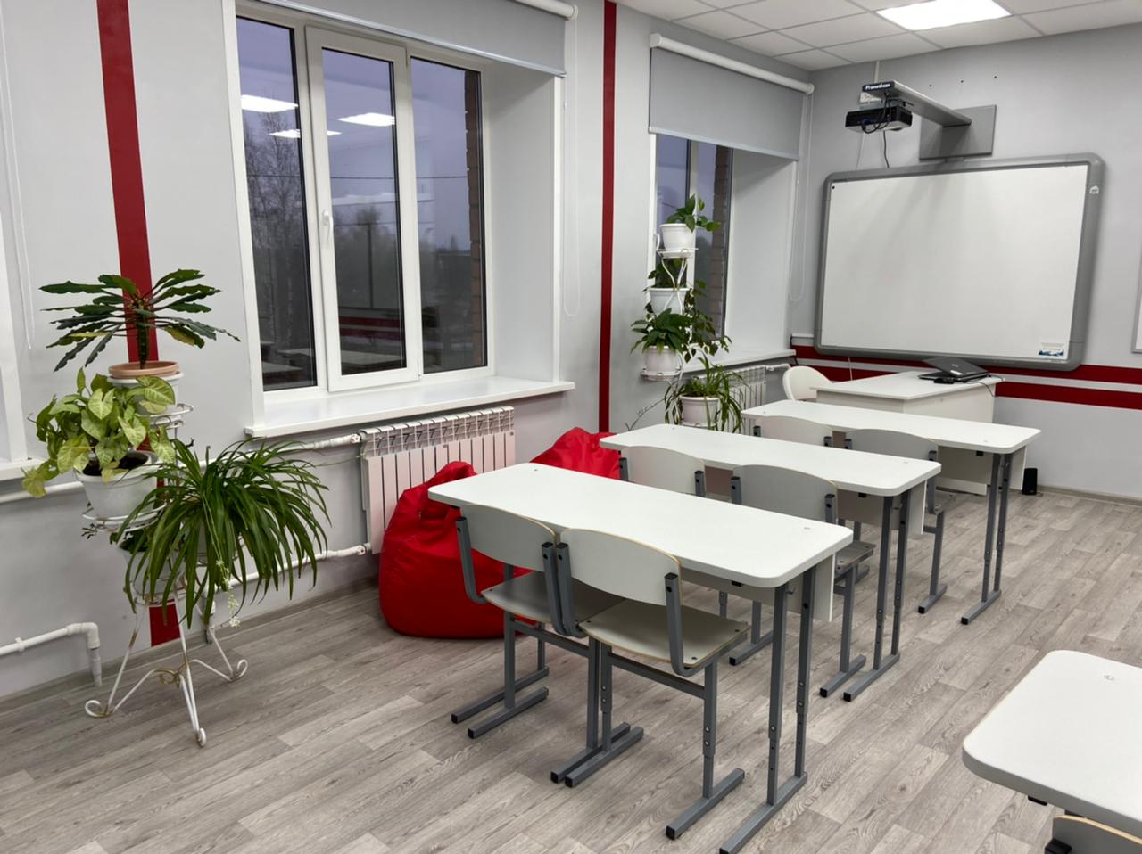
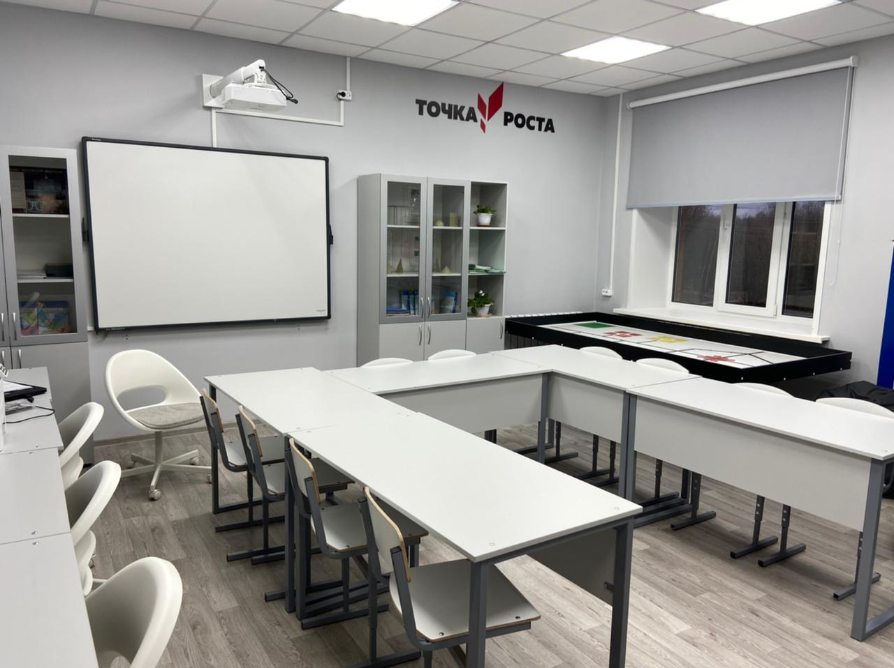
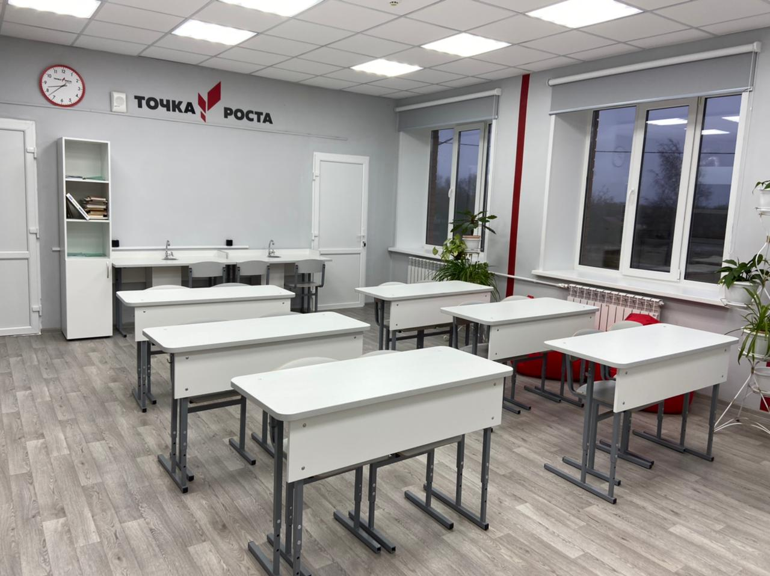
Welcome! The center "Point of Growth" of the Vysheslavskaya Middle School opened in September 2021. It consists of two laboratories focusing on natural science and technology.

Slide 2
The laboratories are equipped with modern equipment including an electron microscope, sensors of various characteristics, research kits, programmable constructors and others.

Slide 3
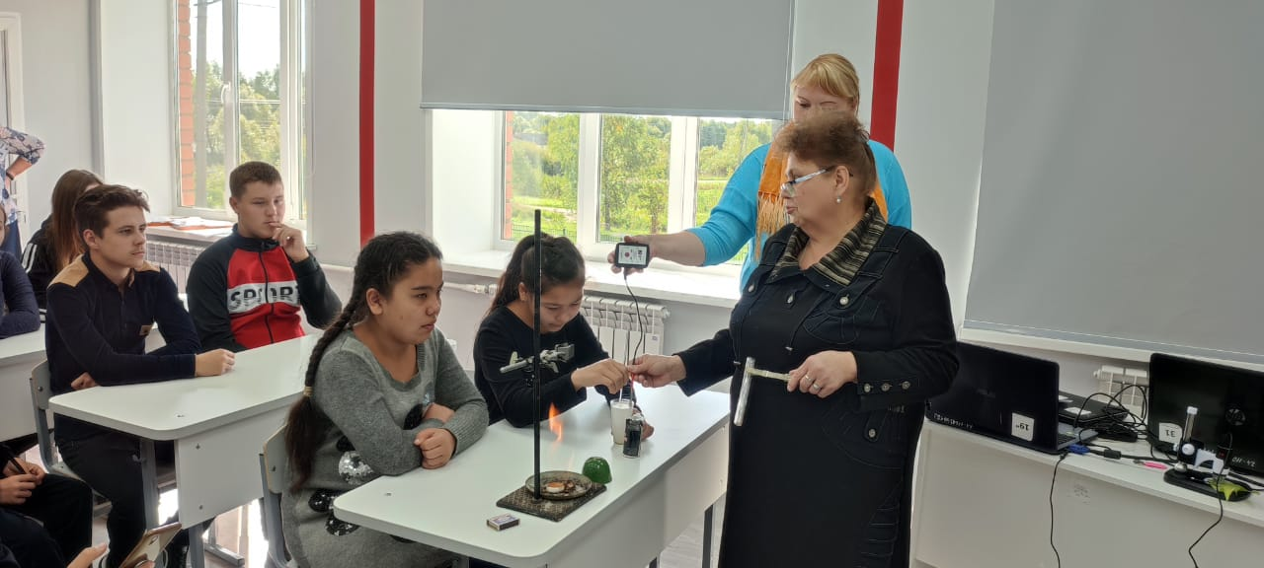
It is there that biology, chemistry, physics classes.

Slide 4
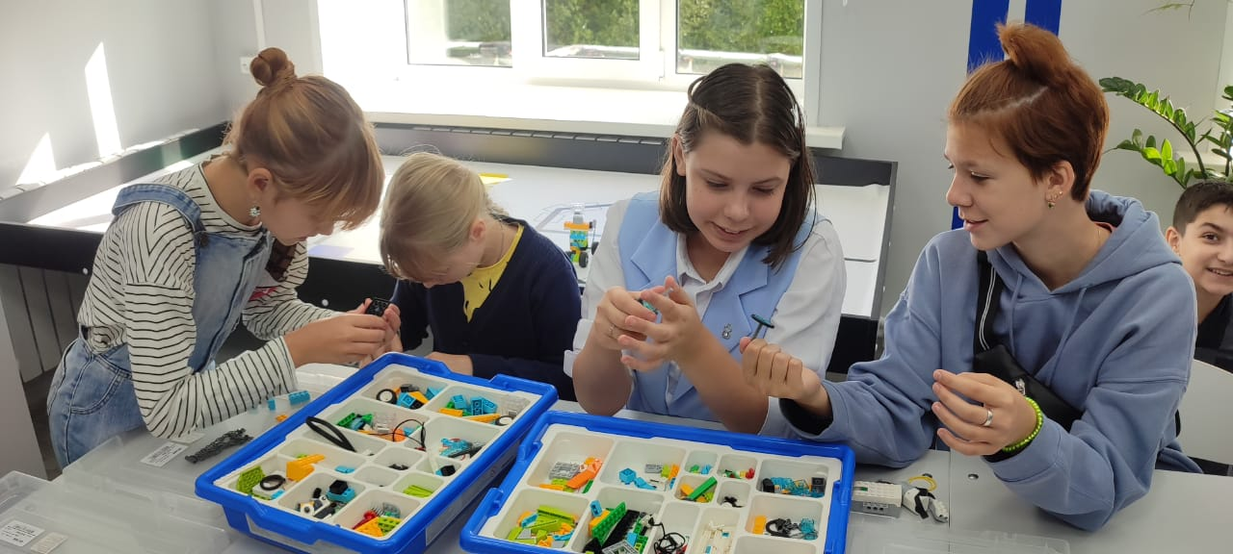
It is there that technology, robotics classes…

Slide 5
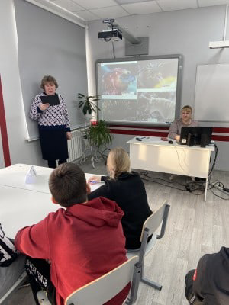
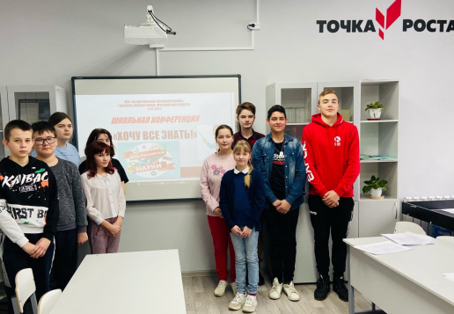
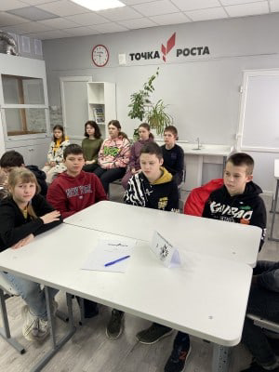
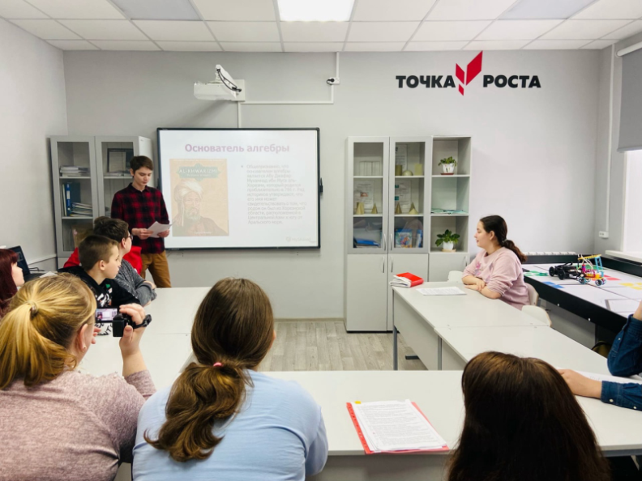
and extracurricular activities are held as well as events like conferences, tournaments and lectures.

Slide 6
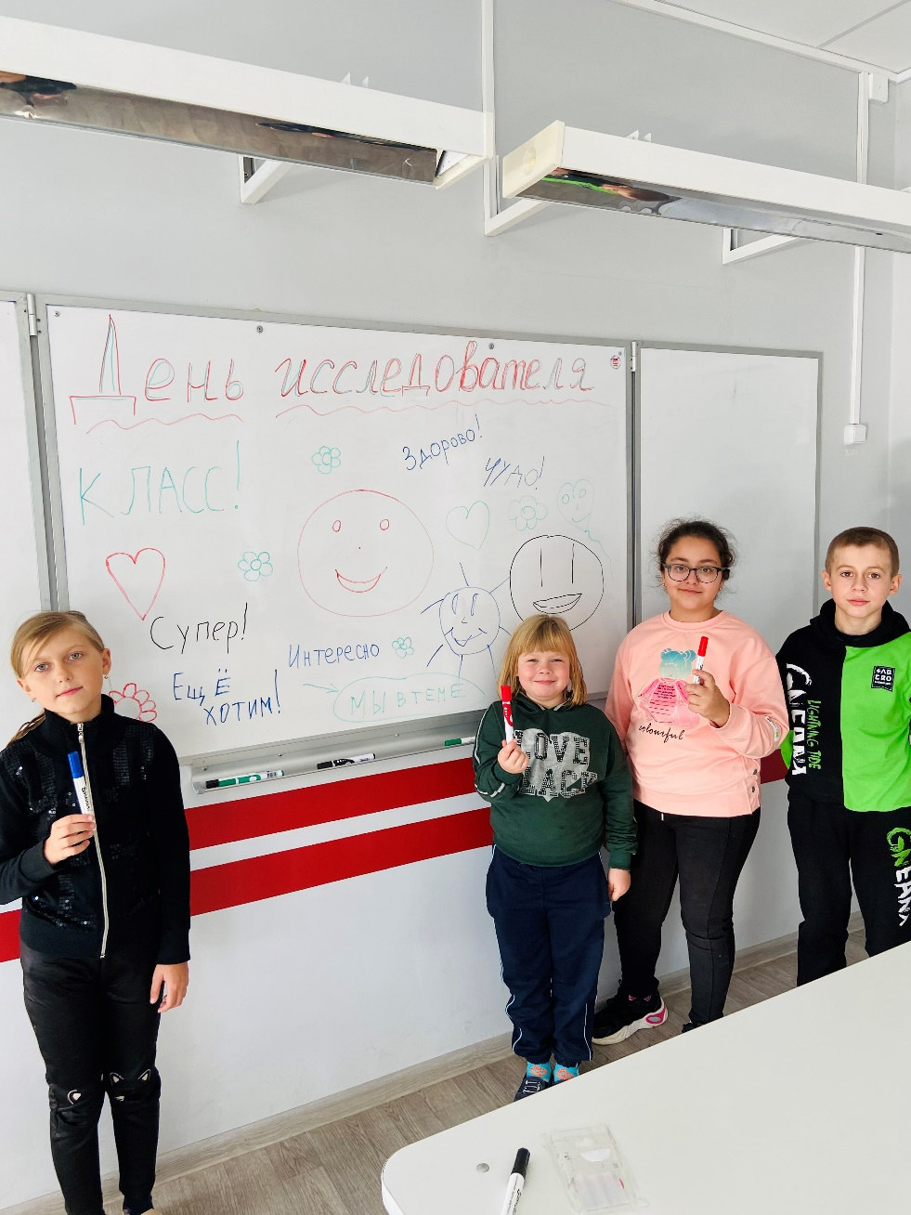
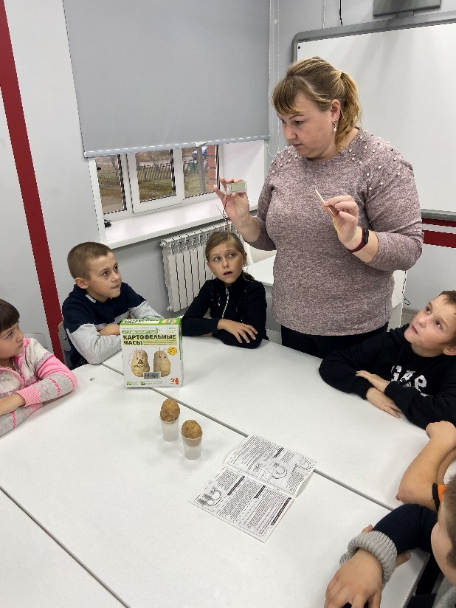
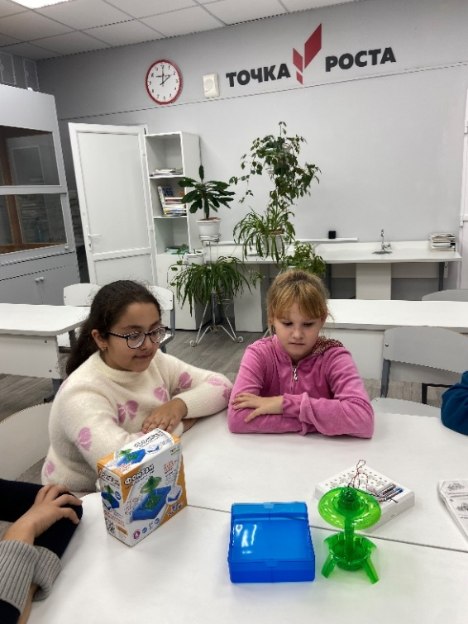
Schoolchildren conduct experiments

Slide 7
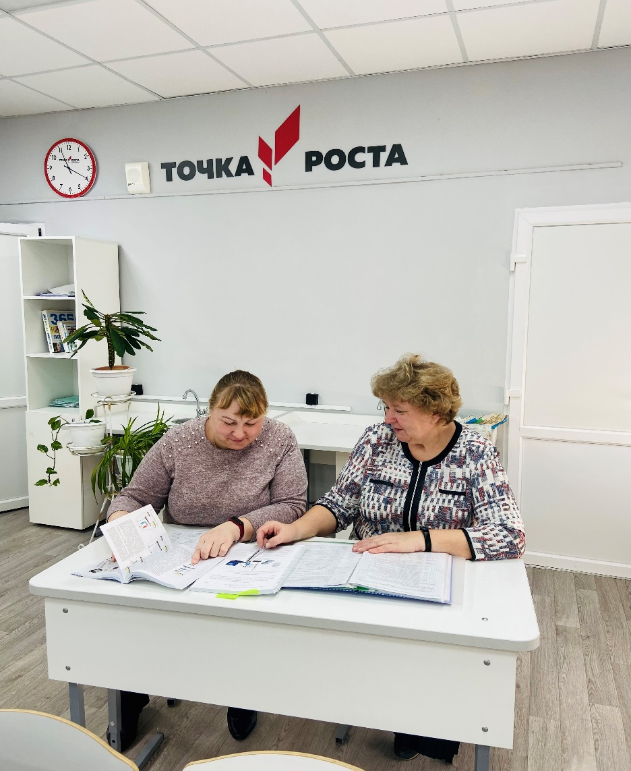
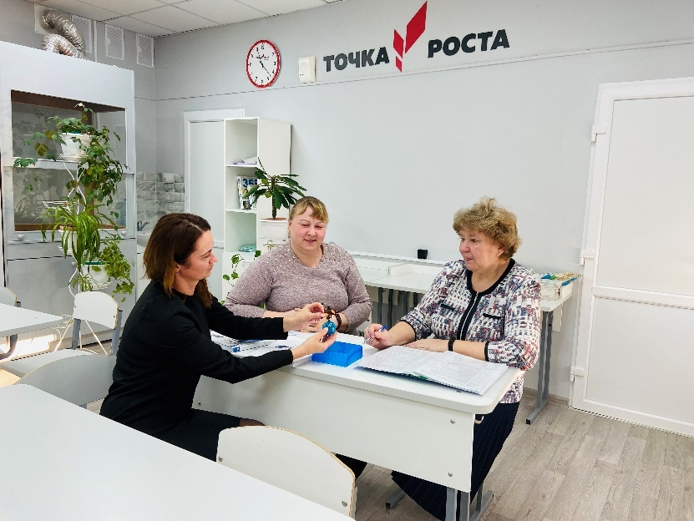
Teachers are preparing for lessons

Slide 8
Welcome! Vysheslavskaya Middle School 29 Shkolnaya Str., Proshenino village, Gavrilov-Yamsky district, Yaroslavl region, 152244 Russia

